Slide 1

Azure 認知服務動手實驗

Slide 2

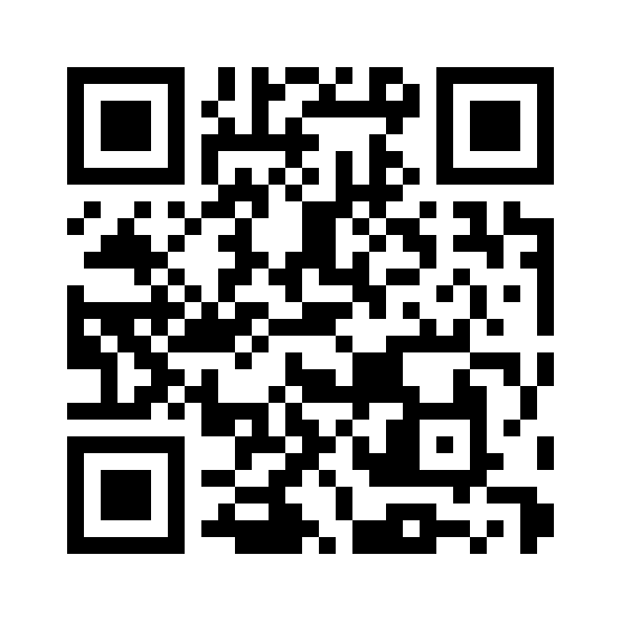



Download Today’s Event Resources Includes free learning path courses & documentation on AI Fundamentals (Scan QR Code)
Stay Connected with Us!
youtube.com/microsofthk
@mshktech
https://aka.ms/AAer0x6
@Microsoft HK Dev Community

Slide 3
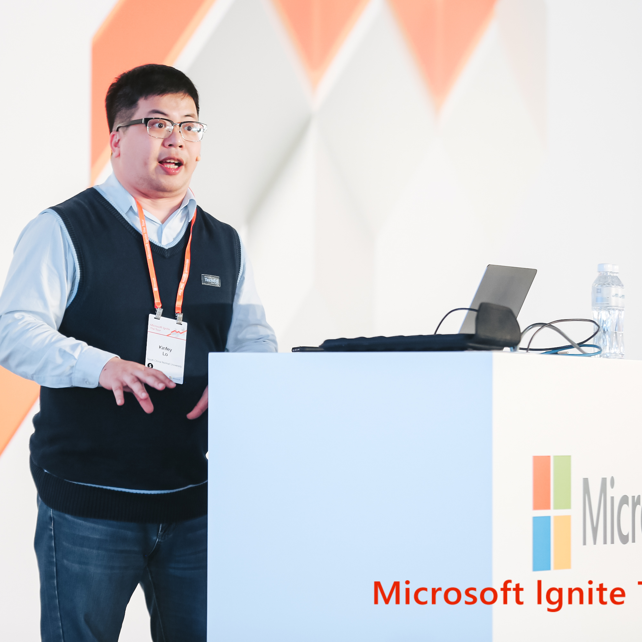

我係
Kinfey Lo – (盧建暉)
Microsoft Cloud Advocate
前微軟MVP、Xamarin MVP和微軟RD，擁有超過10年的雲原生、人工智能和流動應用開發經驗，為教育、金融和醫療提供應用。 在微軟，為技術人員和不同行業宣講技術和相關應用場景。
Love Coding(Python , C# , TypeScript , Swift , Rust , Go )
專注於人工智能，雲原生，流動平台移動開發
Github : https://github.com/kinfey
Email : kinfeylo@microsoft.com Blog : https://dev.to/kinfey
Twitter : @Ljh8304

Slide 4

Microsoft AI 介紹

Slide 5
:
Azure
世界的超級電腦
the world’s computer

Slide 6
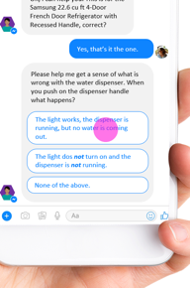
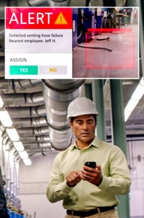
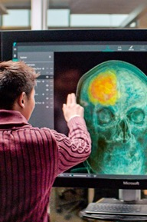


人工智慧的場景
新一代商務場景
B2B, B2C, B2E
人員、對象
和活動檢測
零售、製造、安全
人工智慧
輔助專業人員
市場營銷、法律、金融
知識挖掘
文件、視頻
自動化系統
車輛、網路

Slide 7
Azure AI
符合條件
關鍵任務
負責任
Scenario specific services
Bot Service
Cognitive Search
Form Recognizer
Video Indexer
Customizable AI models
Vision, Speech, Language, Decision
Azure Cognitive Services
Machine Learning service
Azure Machine Learning
Notes:
So What is Azure AI?
Azure AI is a set of AI services that are built upon Azure and deeply integrated with Azure’s Data, App Development, Compute services and tools.
With Azure Machine Learning, we provide data scientists and developers to build, train and deploy models.
AML is the only cloud ML service that enables developers of all skill levels to build ML models – from a code first experience, to drag & drop, to automated machine learning where developers are not required to have any ML knowledge. No matter how models are built, they are stored and managed in a central registry.
AML also provides advanced MLOPs capabilities with built-in integration with Azure DevOps. This enables developers to achieve model reproducibility, model validation, model deployment and model retraining capabilities.
Finally, AML is built on an open source foundation. Developers can choose the Python tool and process of their choice and even get started on their laptops. They have the freedom to use Mlflow if they’d like and take advantage of the ONNX Runtime to optimize inferencing on multiple HW targets.
Customizable Vision, Speech, Language & Decision Models:
Built with Azure Machine Learning, we also offer developers the most comprehensive set of domain-specific pre-trained models – 30 across Vision, Speech, Language and Decision making – which are all based on our breakthrough research. Not only does Azure AI have the most number of pre-trained models, we are the only ones that can enable deployment anywhere – on-premises, on the edge and even other clouds through the use of containers.
Scenario Specific Services
Finally, we offer AI applications specific services for professional developers.
Azure Bot Service is built on Azure Bot Framework, the most popular open source based bot framework.
This includes Azure Search, which is the only cloud app search service with built-in AI capabilities. This facilitates the creation of knowledge mining apps.
Form recognizer has been designed to work on specific types of documents – forms. It extracts key value pairs from forms, thereby automating data entry tasks.
Finally, we have Video Indexer. Video Indexer that is used to extract in-depth metadata from video and audio content.
Only Microsoft provides such a comprehensive set of capabilities for professional and citizen developer to harness the potential of AI

Slide 8
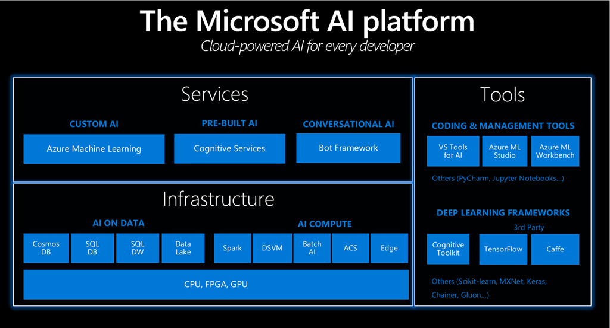
Notes:
the Microsoft AI platform now offers comprehensive cloud-based, on-premises, and edge support – all the infrastructure, tools, frameworks, services and solutions needed for developers, data scientists and businesses to infuse AI into their products and services.
Our customers are using the AI platform to help augment human ingenuity in new ways -- our AI platform allows people to extend their capabilities and tap into even greater potential.
An example is the Helpicto application (Figure 5) developed by a French startup called Equadex.
Helpicto provides an innovative solution to help children with autism communicate more easily with their environment, based on pictograms and associated keywords.

Slide 9

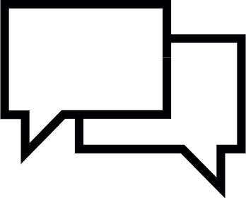



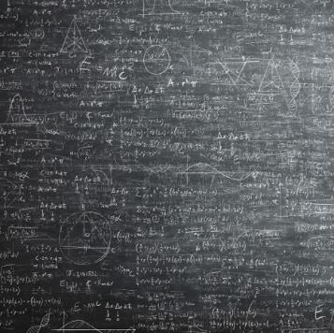
Azure 認知服務 Azure Cognitive Services
感知Perception
理解
Comprehension
視像 Vision
語音 Speech
語言 Language
知識 Knowledge

Slide 10
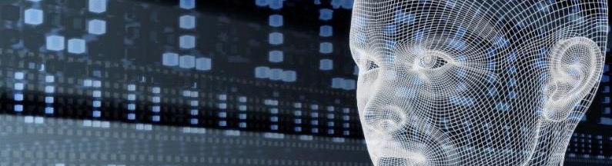





Azure Cognitive Services
賦予您的應用人性化的一面
Vision
Speech
Language
Decision
Computer Vision
Face
Form Recognizer
Ink Recognizer
Video Indexer
Speech To Text
Text To Speech
Speech Translation
Speaker Recognition
Immersive Reader
QnA Maker
Text Analytics
Translator
Anomaly Detector
Content Moderator
Personalizer
CUSTOMIZATION
Custom Vision Service
Custom Speech Service
Language Understanding
Custom Decision Service

Slide 11

Azure Cognitive Services 核心差異化
突破性研究
可執行在任意終端
全面可靠
…
Speech
Language
Vision
Web search
率先實現超越人類
邊緣設備的容器支持
14 個GA服務
在 25 個 Azure 區域
30 多項合規認證
Notes:
Powered by breakthrough research - This is critical to call out as our Vision API just won the NIST (https://www.nist.gov/) competition. In addition we have been the first company to reach “Human Parity” in Vision, Speech, Translation and Reading comprehension.
Run Anywhere - Containerized. Note we containerizing the entire cloud service as Windows or Linux containers. These are large models and you can only deploy them currently in Intel processors. We are enabling GPU support as these models are cloud scale and cannot be run in every edge device yet.
Comprehensive & Compliant - 25 Azure regions, 31 new certifications in last 6 months

Slide 12


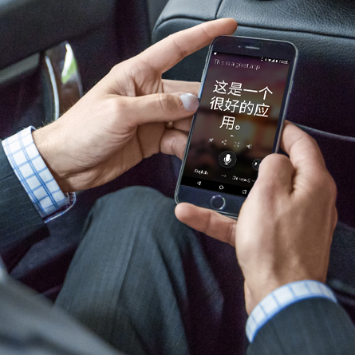
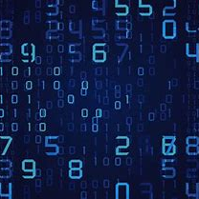
微軟人工智慧爆點
Microsoft AI breakthroughs
視覺
Vision
語音
Speech
語言
Language
Switchboard
Meeting speech
96%
RESNET vision test 152 layers
5.1%
Switchboard speech recognition test
69.9%
MT research system
88.5%
SQuAD reading comprehension test
Broadcast speech
Switchboard cellular
IBM Switchboard
2016
Object recognition Human parity
2017
Speech recognition Human parity
March 2018
Machine translation Human parity
January 2018
Machine reading comprehension Human parity
1993
2000
2006
2010
2017
Notes:
Microsoft innovations in AI

Slide 13
Microsoft Cognitive Service 產業應用介紹

Slide 14
從工業 4.0 談起

Slide 15

製造業中的人工智慧
吸引客戶
賦能員工
優化運營
改造產品

Slide 16

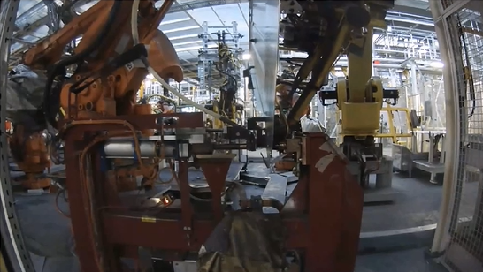
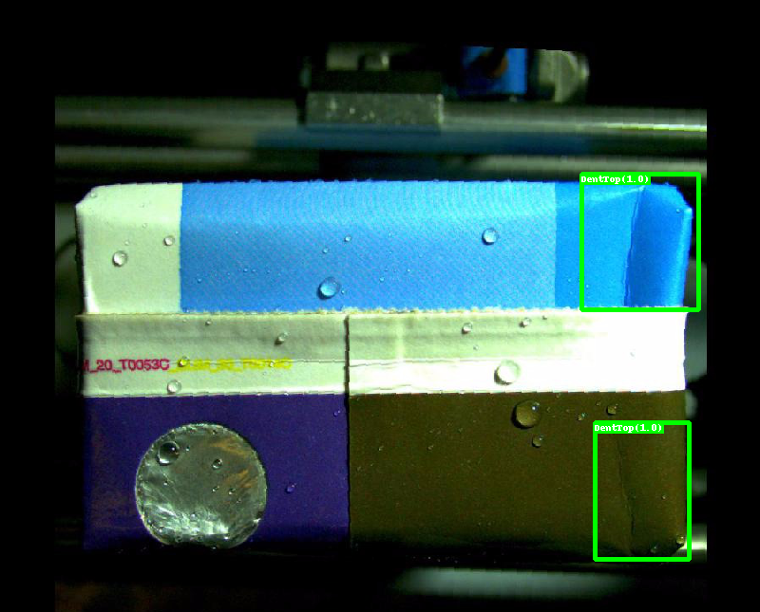

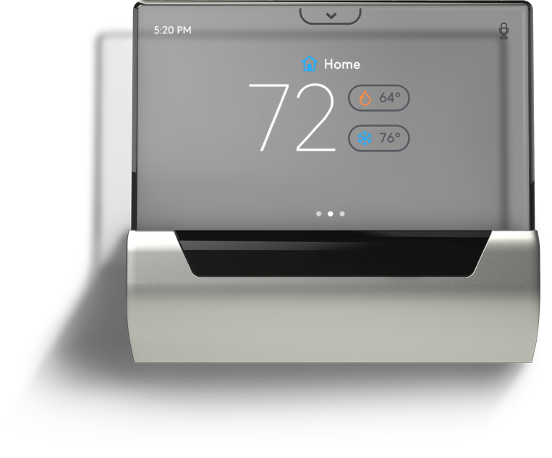
Computers understanding the world
製作業中的案例
質量方案
認知情景
視頻監控
安全
視覺
知識庫
語音
16

Slide 17
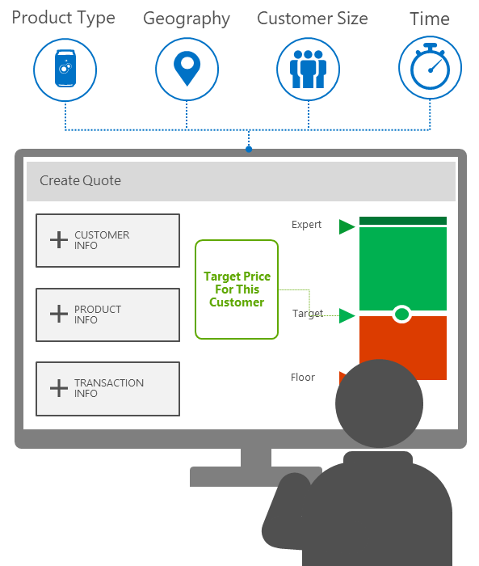
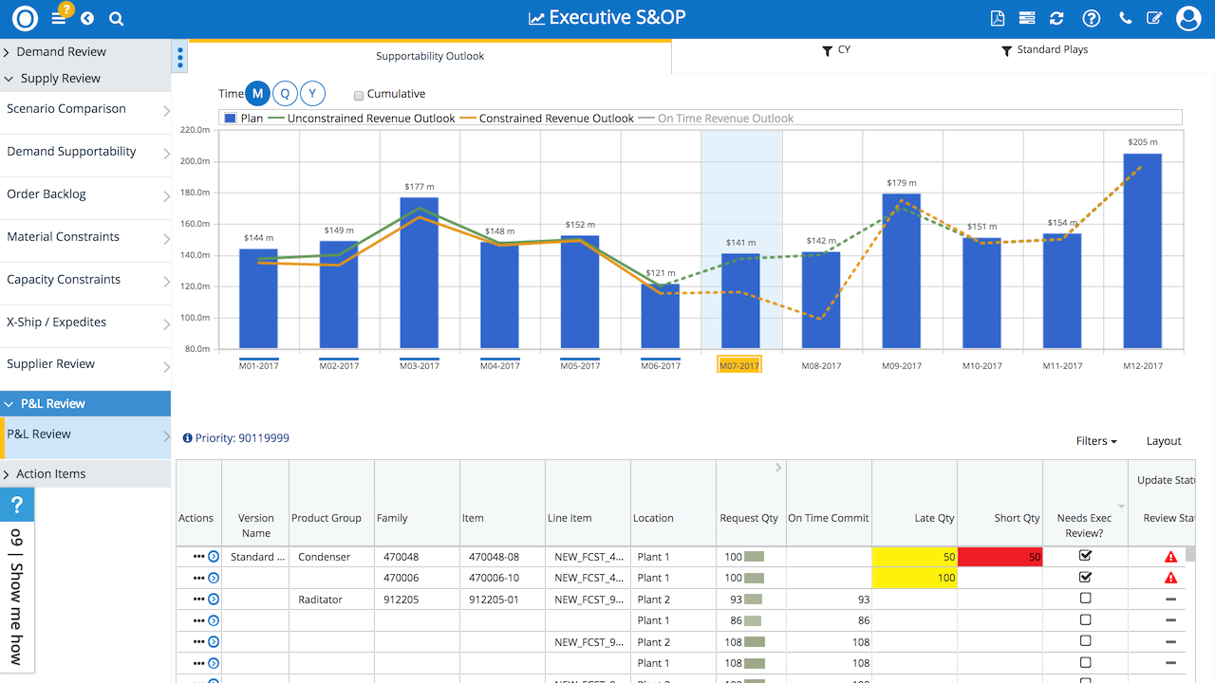


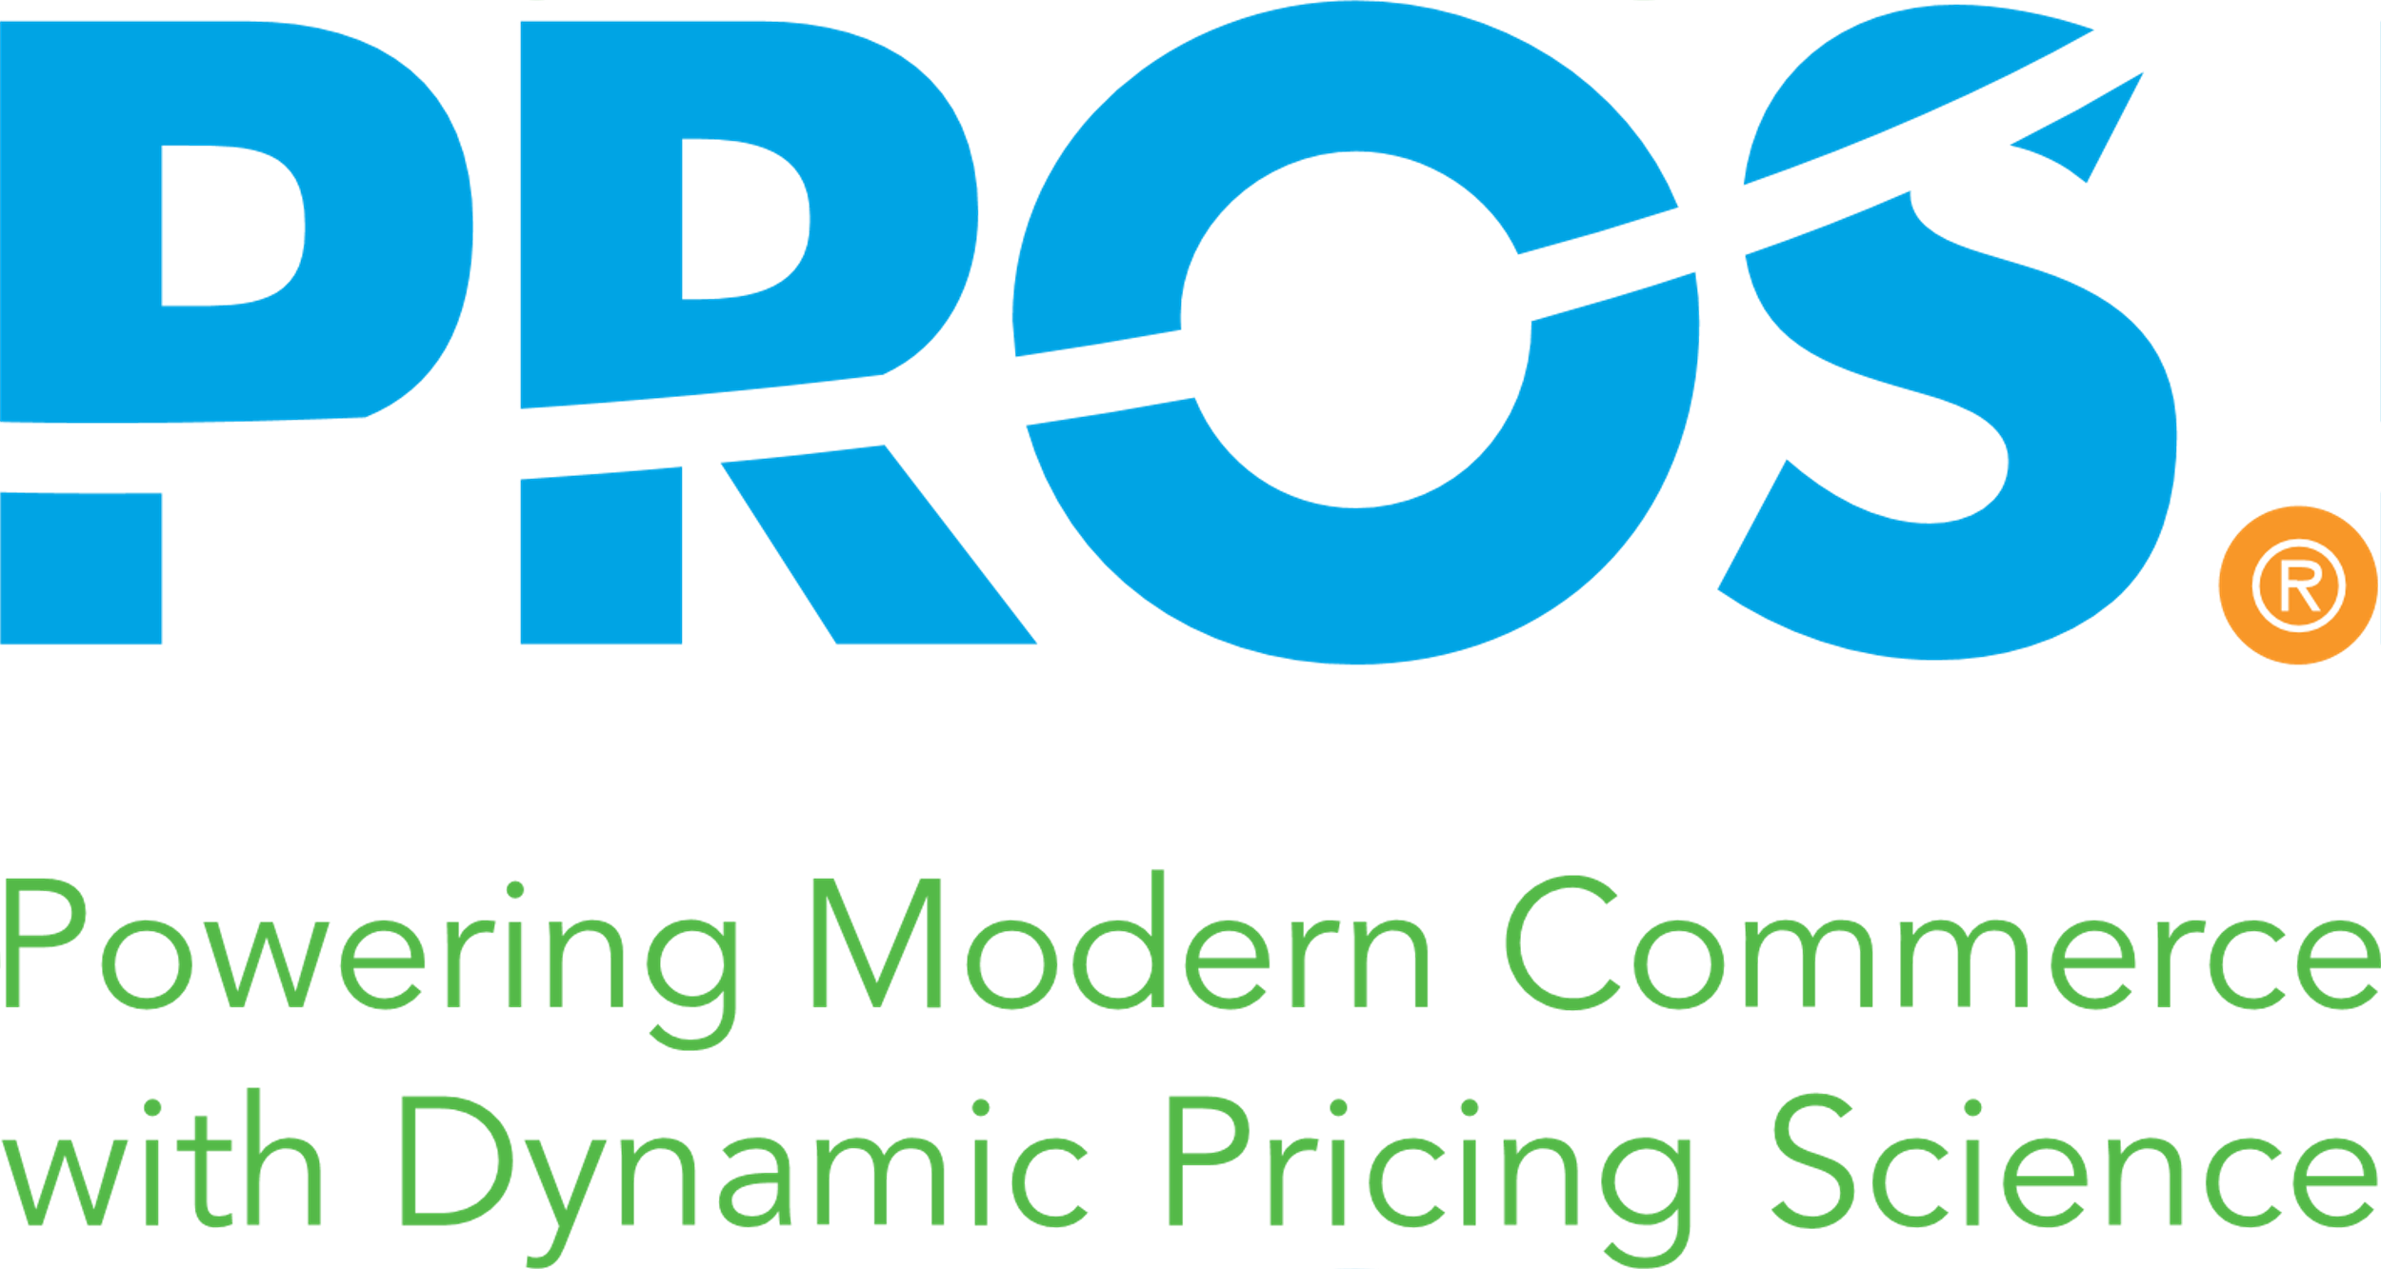

Computers understanding the world
合作夥伴啟用方案
AI based Contract Management
AI Based Dynamic Pricing
AI Based Integrated Planning & Ops
17

Slide 18
案例一
1

Slide 19
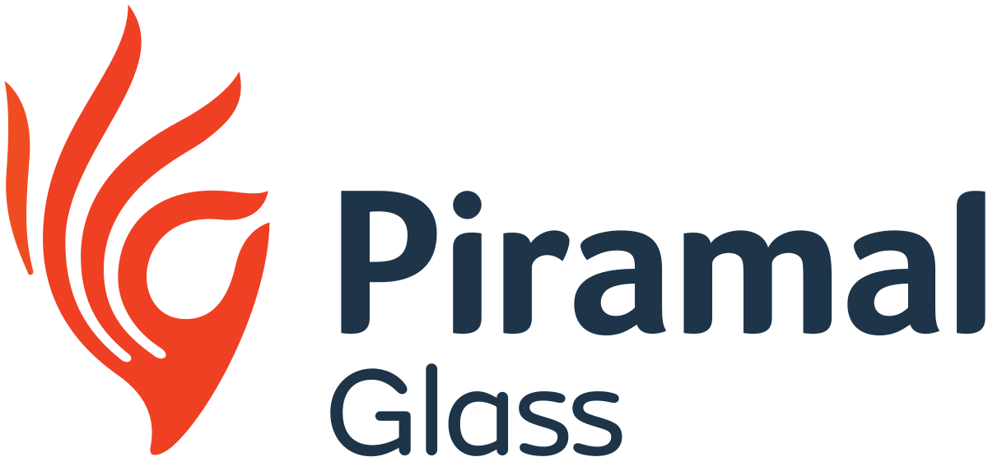
認知服務案例學習 – 匹拉摩玻璃
Piramal Glass 擁有 60 條生產線，每天生產 1,375 噸玻璃單元，所有這些生產線都是 24/7 全天候運行。玻璃製造涉及多個階段，例如批量製備、熔爐中的原材料熔化、瓶子成型、處理、各種質量檢查和包裝。在一天之內，Piramal Glass 在其生產線上生產了數十種瓶子。
玻璃容器是在一個非常複雜的連續製造過程中生產的，因為有許多參數會影響質量。如果生產批次在質量控製過程中出現較高的廢品率，通常會在下一批中進行糾正，從而導致生產損失。
此外，每個批次的數據都是手動收集的。工廠人員將在紙質日誌中捕獲數據，事實證明這些日誌難以分析，並且無法提供及時的見解來改進生產。因此，Piramal Glass 計劃提高生產效率並最大限度地減少缺陷，以利用技術改變其製造流程。
“我們的願景是成為一個洞察力驅動的組織，每個員工都可以在我們製造的每一瓶酒中結合手工藝和科學。最終，我們預計數字技術的使用將成為我們邁向工業 4.0 的基礎，”Piramal Glass 首席數字官Poorav Sheth 說。
Notes:
So What is Azure AI?
Azure AI is a set of AI services that are built upon Azure and deeply integrated with Azure’s Data, App Development, Compute services and tools.
With Azure Machine Learning, we provide data scientists and developers to build, train and deploy models.
AML is the only cloud ML service that enables developers of all skill levels to build ML models – from a code first experience, to drag & drop, to automated machine learning where developers are not required to have any ML knowledge. No matter how models are built, they are stored and managed in a central registry.
AML also provides advanced MLOPs capabilities with built-in integration with Azure DevOps. This enables developers to achieve model reproducibility, model validation, model deployment and model retraining capabilities.
Finally, AML is built on an open source foundation. Developers can choose the Python tool and process of their choice and even get started on their laptops. They have the freedom to use Mlflow if they’d like and take advantage of the ONNX Runtime to optimize inferencing on multiple HW targets.
Customizable Vision, Speech, Language & Decision Models:
Built with Azure Machine Learning, we also offer developers the most comprehensive set of domain-specific pre-trained models – 30 across Vision, Speech, Language and Decision making – which are all based on our breakthrough research. Not only does Azure AI have the most number of pre-trained models, we are the only ones that can enable deployment anywhere – on-premises, on the edge and even other clouds through the use of containers.
Scenario Specific Services
Finally, we offer AI applications specific services for professional developers.
Azure Bot Service is built on Azure Bot Framework, the most popular open source based bot framework.
This includes Azure Search, which is the only cloud app search service with built-in AI capabilities. This facilitates the creation of knowledge mining apps.
Form recognizer has been designed to work on specific types of documents – forms. It extracts key value pairs from forms, thereby automating data entry tasks.
Finally, we have Video Indexer. Video Indexer that is used to extract in-depth metadata from video and audio content.
Only Microsoft provides such a comprehensive set of capabilities for professional and citizen developer to harness the potential of AI

Slide 20

認知服務案例學習 – 匹拉摩玻璃
Piramal Glass 正在使用 Microsoft 認知服務平台AI 和機器學習模型，以解決每個生產批次的異常檢測、生產效率、缺陷因果關係和產品質量問題。 該公司正在創建其所有設備和流程的統一視圖，以創建製造工廠的數字雙胞胎。
Notes:
So What is Azure AI?
Azure AI is a set of AI services that are built upon Azure and deeply integrated with Azure’s Data, App Development, Compute services and tools.
With Azure Machine Learning, we provide data scientists and developers to build, train and deploy models.
AML is the only cloud ML service that enables developers of all skill levels to build ML models – from a code first experience, to drag & drop, to automated machine learning where developers are not required to have any ML knowledge. No matter how models are built, they are stored and managed in a central registry.
AML also provides advanced MLOPs capabilities with built-in integration with Azure DevOps. This enables developers to achieve model reproducibility, model validation, model deployment and model retraining capabilities.
Finally, AML is built on an open source foundation. Developers can choose the Python tool and process of their choice and even get started on their laptops. They have the freedom to use Mlflow if they’d like and take advantage of the ONNX Runtime to optimize inferencing on multiple HW targets.
Customizable Vision, Speech, Language & Decision Models:
Built with Azure Machine Learning, we also offer developers the most comprehensive set of domain-specific pre-trained models – 30 across Vision, Speech, Language and Decision making – which are all based on our breakthrough research. Not only does Azure AI have the most number of pre-trained models, we are the only ones that can enable deployment anywhere – on-premises, on the edge and even other clouds through the use of containers.
Scenario Specific Services
Finally, we offer AI applications specific services for professional developers.
Azure Bot Service is built on Azure Bot Framework, the most popular open source based bot framework.
This includes Azure Search, which is the only cloud app search service with built-in AI capabilities. This facilitates the creation of knowledge mining apps.
Form recognizer has been designed to work on specific types of documents – forms. It extracts key value pairs from forms, thereby automating data entry tasks.
Finally, we have Video Indexer. Video Indexer that is used to extract in-depth metadata from video and audio content.
Only Microsoft provides such a comprehensive set of capabilities for professional and citizen developer to harness the potential of AI

Slide 21
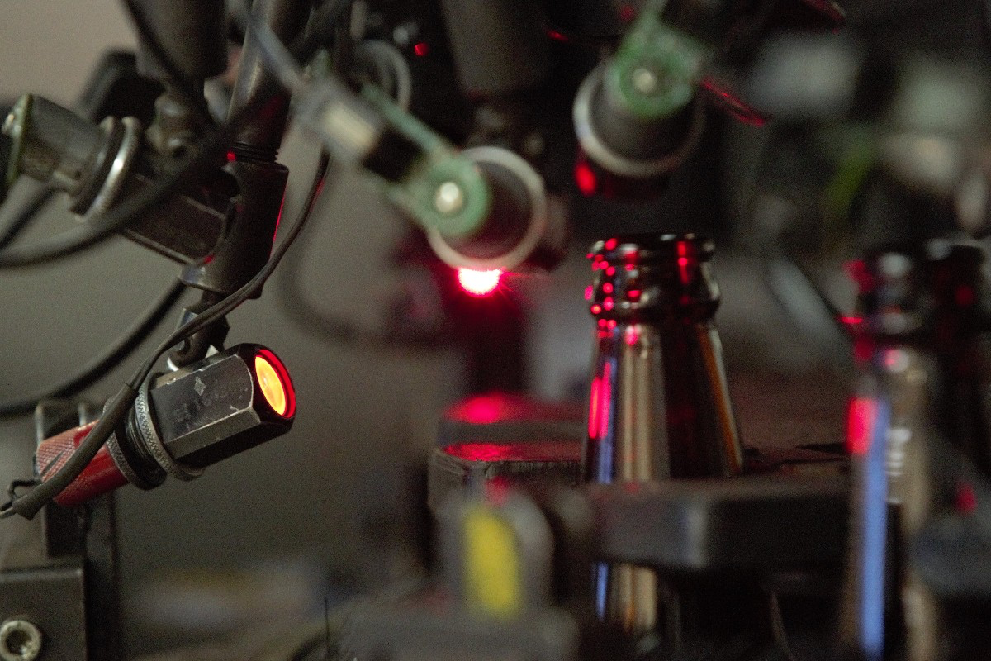
認知服務案例學習 – 匹拉摩玻璃
Notes:
So What is Azure AI?
Azure AI is a set of AI services that are built upon Azure and deeply integrated with Azure’s Data, App Development, Compute services and tools.
With Azure Machine Learning, we provide data scientists and developers to build, train and deploy models.
AML is the only cloud ML service that enables developers of all skill levels to build ML models – from a code first experience, to drag & drop, to automated machine learning where developers are not required to have any ML knowledge. No matter how models are built, they are stored and managed in a central registry.
AML also provides advanced MLOPs capabilities with built-in integration with Azure DevOps. This enables developers to achieve model reproducibility, model validation, model deployment and model retraining capabilities.
Finally, AML is built on an open source foundation. Developers can choose the Python tool and process of their choice and even get started on their laptops. They have the freedom to use Mlflow if they’d like and take advantage of the ONNX Runtime to optimize inferencing on multiple HW targets.
Customizable Vision, Speech, Language & Decision Models:
Built with Azure Machine Learning, we also offer developers the most comprehensive set of domain-specific pre-trained models – 30 across Vision, Speech, Language and Decision making – which are all based on our breakthrough research. Not only does Azure AI have the most number of pre-trained models, we are the only ones that can enable deployment anywhere – on-premises, on the edge and even other clouds through the use of containers.
Scenario Specific Services
Finally, we offer AI applications specific services for professional developers.
Azure Bot Service is built on Azure Bot Framework, the most popular open source based bot framework.
This includes Azure Search, which is the only cloud app search service with built-in AI capabilities. This facilitates the creation of knowledge mining apps.
Form recognizer has been designed to work on specific types of documents – forms. It extracts key value pairs from forms, thereby automating data entry tasks.
Finally, we have Video Indexer. Video Indexer that is used to extract in-depth metadata from video and audio content.
Only Microsoft provides such a comprehensive set of capabilities for professional and citizen developer to harness the potential of AI

Slide 22
案例二
2

Slide 23


Jabil 通過預測功能最大限度地減少停機時間
‟
我們已經看到至少 80% 的準確率可以預測機器流程將減慢或失敗，從而節省 17% 的廢品和返工。”.”
— Clint Belinsky, Vice President, Global Quality Jabil
Watch
Notes:
Key points:
Customer profile: Jabil Circuit, Inc., is a US-based global manufacturing services company. Headquartered in St. Petersburg, Florida, it is one of the largest companies in the Tampa Bay area, and the third largest contract manufacturer in the world. Jabil has facilities 100 locations in 28 countries, and 180,000 employees. The revenue in 2015 was $17.9 billion. Jabil’s engineering, manufacturing, and intelligent supply chain solutions help customers capitalize on accelerated changes in business and achieve digital business advantage. | http://www.jabil.com
Challenge: Jabil wanted to minimize downtime by creating digital, intelligent, and predictive factories.
Solution: Working with Microsoft, Jabil created new digital factories at plants in Mexico and Malaysia. These factories are using machine learning, predictive analytics, and the cloud to analyze millions of data points from machines to identify errors or failures early in the manufacturing process—before they even occurred.
Benefits: Rockwell was able to predict machine processes that would slow down or fail with 80 percent accuracy. They were also able to deliver an energy savings of 10 percent and reduced costs of scrap and rework by 17 percent. Jabil’s Vice President for Global Quality, Clint Belinsky, stated: “That’s a huge improvement. And the accuracy rate has been at least 80 percent in the prediction of machine processes that will slow down or fail, contributing to a scrap and rework savings of 17 percent, and an energy savings of 10 percent.”
Additional information:
https://customers.microsoft.com/en-us/story/from-the-factory-floor-to-the-cloud-integrating-predic
http://blogs.microsoft.com/transform/2016/04/24/how-manufacturers-are-creating-the-digital-intelligent-and-predictive-factory/#sm.0001q3qurpfqzdmzshm1ze5411zli
https://news.microsoft.com/2016/04/25/microsoft-and-jabil-collaborate-to-create-quality-assurance-platform-for-predictive-analytics/#tVb0qsJghUHg65Kq.97

Slide 24
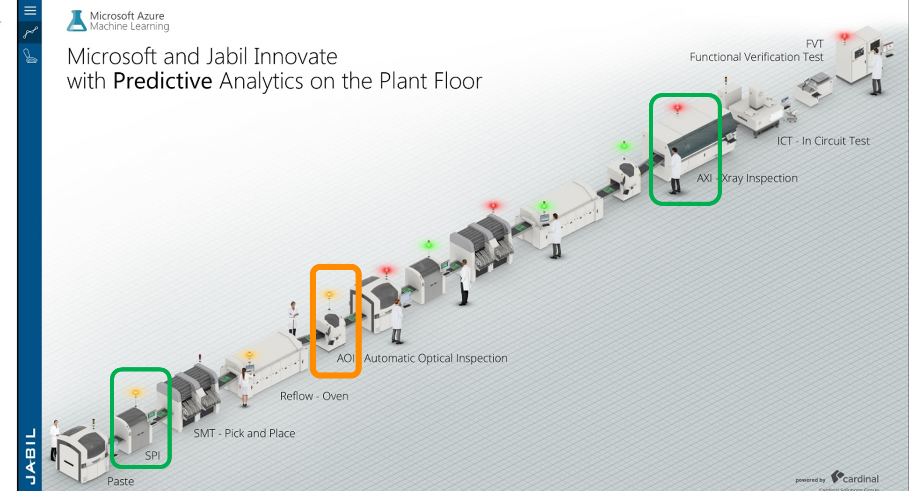
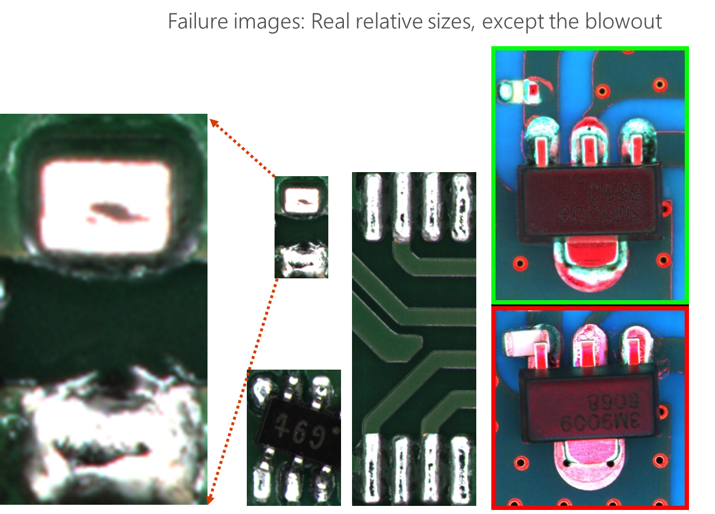
Jabil 預測分析
提高質量
在上游過程中預測下游缺陷產品發生之前
用於預警檢測的高級統計
設備優化
用於自主設備調整的機器學習算法
無需操作員干預的 M2M
增加設備正常運行時間
通過預測未來的設備故障避免計劃外停機
優化維護計劃並降低成本
解決方法
使用具有 50 個隱藏層的捲積神經網絡 (CNN) 的圖像分類系統，在通用公共數據 (ImageNet) 上進行了預訓練。
分類性能結果良好（基於時間的交叉驗證概率 >0.9），這表明該解決方案適用於大幅減少組裝電路板中電子元件故障檢測的人為乾預.
Notes:
faulty circuit boards are costly in circuit board manufacturing
assembly lines rely on human operators to review and validate boards failures
short time window
Analyze electronic component images generated by assembly line test machine cameras in a circuit board manufacturing plant
detects their error status with the goal of minimizing or removing the need for human intervention.
The solution uses an image classification system using a convolutional neural network with 50 hidden layers, pretrained on generic public data (ImageNet).
The classification performance results are good (time based cross-validation AUC>.90) which indicates the solution is suitable to drastically minimize human intervention for electronic components failure detection in assembled circuit boards.

Slide 25

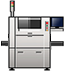






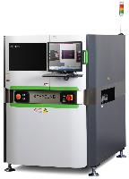
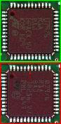
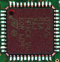


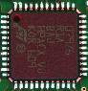
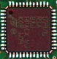

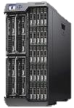
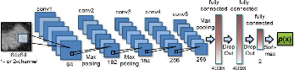
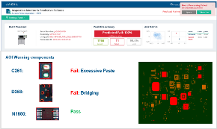

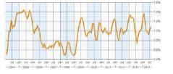
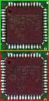

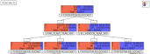
AOI Predictive Analysis
Printer
SPI
Pick & Place
Reflow Oven
AOI
Feedback
Operator / MT 可以輕鬆解讀圖表并快速採取行動
受影響工具的清晰可視化
快速共性分析
使用根本原因和操作更新了儀表板
指尖信息
減少人為決策
Step 1 – Image cropping
Result
Step2 – Resize image for inputting to model
Alert Detected with RCA & Action
Virtual Machine
Component Level detail
Analytic & Storage
Step3 – Prediction
Connect to manufacturing LAN
Good / Defect
Machine Log
Step4 – Trend detection
Component Image File
Step5 – Root Cause Analysis &Action
Prediction Result
Dashboard
Notes:
AOI = Automated Optical Inspection
SPI = Solder Paste Inspection

Slide 26
技術實踐

Slide 27
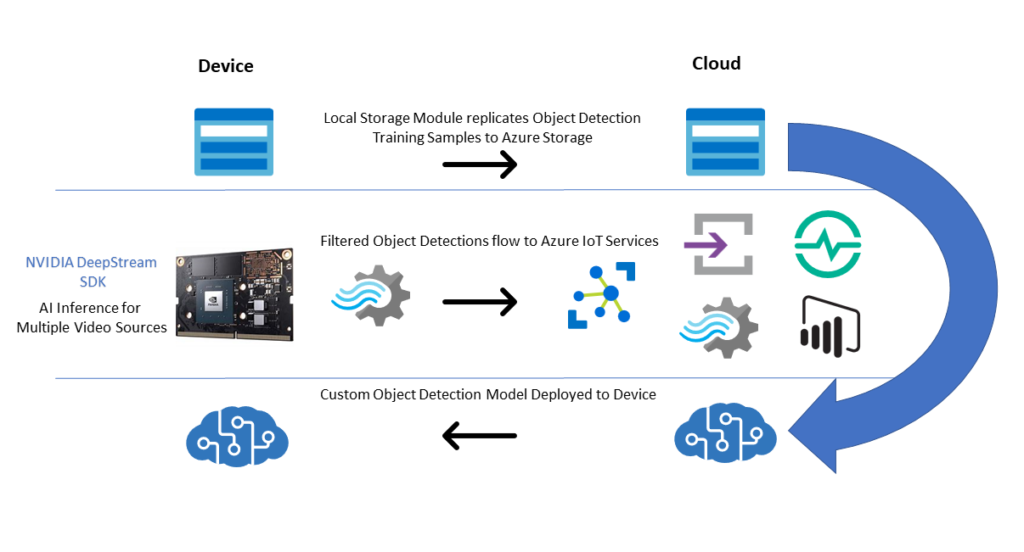
電腦視覺應用場景架構圖
Notes:
So What is Azure AI?
Azure AI is a set of AI services that are built upon Azure and deeply integrated with Azure’s Data, App Development, Compute services and tools.
With Azure Machine Learning, we provide data scientists and developers to build, train and deploy models.
AML is the only cloud ML service that enables developers of all skill levels to build ML models – from a code first experience, to drag & drop, to automated machine learning where developers are not required to have any ML knowledge. No matter how models are built, they are stored and managed in a central registry.
AML also provides advanced MLOPs capabilities with built-in integration with Azure DevOps. This enables developers to achieve model reproducibility, model validation, model deployment and model retraining capabilities.
Finally, AML is built on an open source foundation. Developers can choose the Python tool and process of their choice and even get started on their laptops. They have the freedom to use Mlflow if they’d like and take advantage of the ONNX Runtime to optimize inferencing on multiple HW targets.
Customizable Vision, Speech, Language & Decision Models:
Built with Azure Machine Learning, we also offer developers the most comprehensive set of domain-specific pre-trained models – 30 across Vision, Speech, Language and Decision making – which are all based on our breakthrough research. Not only does Azure AI have the most number of pre-trained models, we are the only ones that can enable deployment anywhere – on-premises, on the edge and even other clouds through the use of containers.
Scenario Specific Services
Finally, we offer AI applications specific services for professional developers.
Azure Bot Service is built on Azure Bot Framework, the most popular open source based bot framework.
This includes Azure Search, which is the only cloud app search service with built-in AI capabilities. This facilitates the creation of knowledge mining apps.
Form recognizer has been designed to work on specific types of documents – forms. It extracts key value pairs from forms, thereby automating data entry tasks.
Finally, we have Video Indexer. Video Indexer that is used to extract in-depth metadata from video and audio content.
Only Microsoft provides such a comprehensive set of capabilities for professional and citizen developer to harness the potential of AI

Slide 28
醫療保健

Slide 29
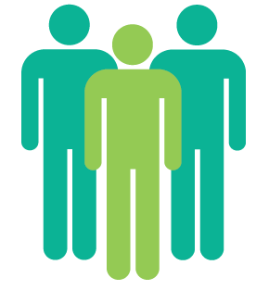
用於醫療保健的 Microsoft AI 體系
數據聯盟
智慧平臺
全球分佈
世界一流
健康提供者 (Data, Knowledge, Validation)
Microsoft Azure
& AI Platform
Feedback Loop
隨時隨地訪問值得信賴的 API (Screening Programs, EMRs, Devices)
API clinical validation
Notes:
We don’t pay upfront; we incentivize partners to share their data and domain knowledge.
They believe that Microsoft will continuously bring state-of-the-art AI
They believe that Microsoft has Global Reach for these APIs

Slide 30
案例一
1

Slide 31
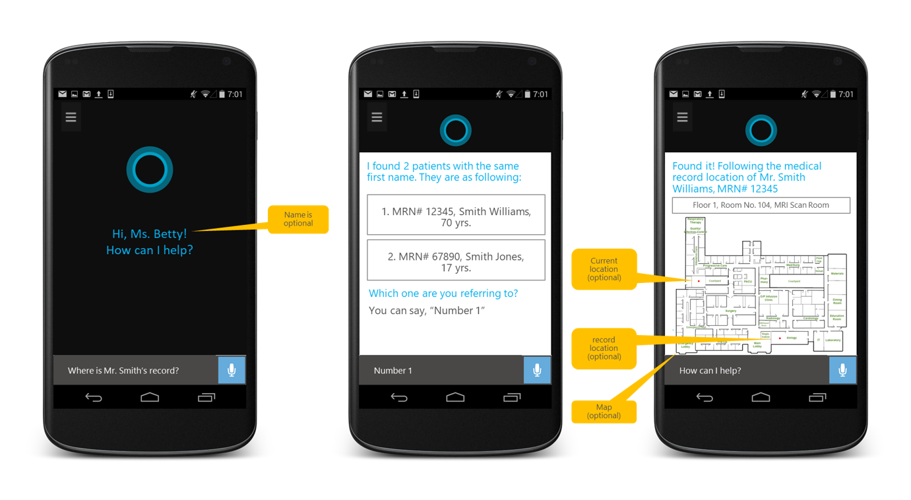
智慧護士助理​
Notes:
So What is Azure AI?
Azure AI is a set of AI services that are built upon Azure and deeply integrated with Azure’s Data, App Development, Compute services and tools.
With Azure Machine Learning, we provide data scientists and developers to build, train and deploy models.
AML is the only cloud ML service that enables developers of all skill levels to build ML models – from a code first experience, to drag & drop, to automated machine learning where developers are not required to have any ML knowledge. No matter how models are built, they are stored and managed in a central registry.
AML also provides advanced MLOPs capabilities with built-in integration with Azure DevOps. This enables developers to achieve model reproducibility, model validation, model deployment and model retraining capabilities.
Finally, AML is built on an open source foundation. Developers can choose the Python tool and process of their choice and even get started on their laptops. They have the freedom to use Mlflow if they’d like and take advantage of the ONNX Runtime to optimize inferencing on multiple HW targets.
Customizable Vision, Speech, Language & Decision Models:
Built with Azure Machine Learning, we also offer developers the most comprehensive set of domain-specific pre-trained models – 30 across Vision, Speech, Language and Decision making – which are all based on our breakthrough research. Not only does Azure AI have the most number of pre-trained models, we are the only ones that can enable deployment anywhere – on-premises, on the edge and even other clouds through the use of containers.
Scenario Specific Services
Finally, we offer AI applications specific services for professional developers.
Azure Bot Service is built on Azure Bot Framework, the most popular open source based bot framework.
This includes Azure Search, which is the only cloud app search service with built-in AI capabilities. This facilitates the creation of knowledge mining apps.
Form recognizer has been designed to work on specific types of documents – forms. It extracts key value pairs from forms, thereby automating data entry tasks.
Finally, we have Video Indexer. Video Indexer that is used to extract in-depth metadata from video and audio content.
Only Microsoft provides such a comprehensive set of capabilities for professional and citizen developer to harness the potential of AI

Slide 32
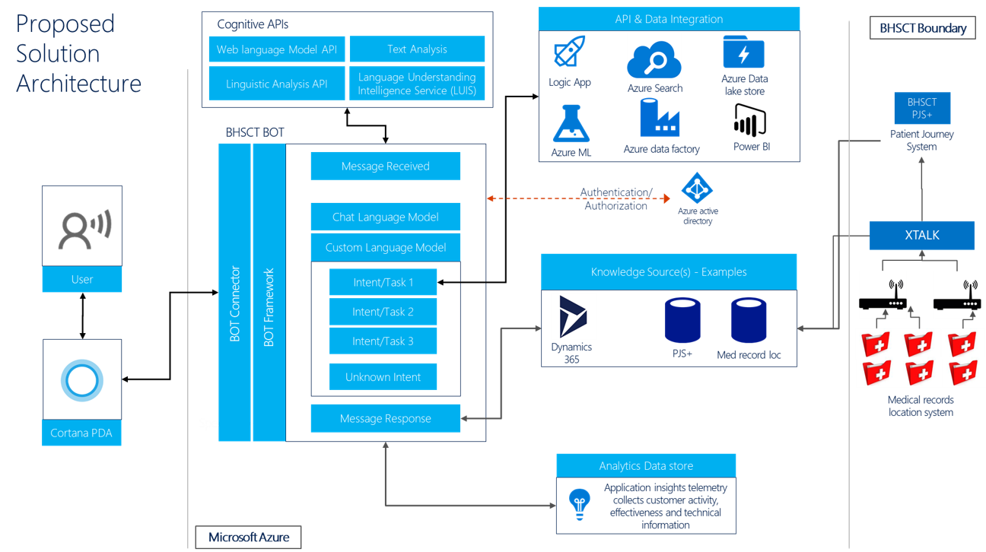
智慧護士助理​
Notes:
So What is Azure AI?
Azure AI is a set of AI services that are built upon Azure and deeply integrated with Azure’s Data, App Development, Compute services and tools.
With Azure Machine Learning, we provide data scientists and developers to build, train and deploy models.
AML is the only cloud ML service that enables developers of all skill levels to build ML models – from a code first experience, to drag & drop, to automated machine learning where developers are not required to have any ML knowledge. No matter how models are built, they are stored and managed in a central registry.
AML also provides advanced MLOPs capabilities with built-in integration with Azure DevOps. This enables developers to achieve model reproducibility, model validation, model deployment and model retraining capabilities.
Finally, AML is built on an open source foundation. Developers can choose the Python tool and process of their choice and even get started on their laptops. They have the freedom to use Mlflow if they’d like and take advantage of the ONNX Runtime to optimize inferencing on multiple HW targets.
Customizable Vision, Speech, Language & Decision Models:
Built with Azure Machine Learning, we also offer developers the most comprehensive set of domain-specific pre-trained models – 30 across Vision, Speech, Language and Decision making – which are all based on our breakthrough research. Not only does Azure AI have the most number of pre-trained models, we are the only ones that can enable deployment anywhere – on-premises, on the edge and even other clouds through the use of containers.
Scenario Specific Services
Finally, we offer AI applications specific services for professional developers.
Azure Bot Service is built on Azure Bot Framework, the most popular open source based bot framework.
This includes Azure Search, which is the only cloud app search service with built-in AI capabilities. This facilitates the creation of knowledge mining apps.
Form recognizer has been designed to work on specific types of documents – forms. It extracts key value pairs from forms, thereby automating data entry tasks.
Finally, we have Video Indexer. Video Indexer that is used to extract in-depth metadata from video and audio content.
Only Microsoft provides such a comprehensive set of capabilities for professional and citizen developer to harness the potential of AI

Slide 33
案例二
2

Slide 34


醫院管理
Notes:
So What is Azure AI?
Azure AI is a set of AI services that are built upon Azure and deeply integrated with Azure’s Data, App Development, Compute services and tools.
With Azure Machine Learning, we provide data scientists and developers to build, train and deploy models.
AML is the only cloud ML service that enables developers of all skill levels to build ML models – from a code first experience, to drag & drop, to automated machine learning where developers are not required to have any ML knowledge. No matter how models are built, they are stored and managed in a central registry.
AML also provides advanced MLOPs capabilities with built-in integration with Azure DevOps. This enables developers to achieve model reproducibility, model validation, model deployment and model retraining capabilities.
Finally, AML is built on an open source foundation. Developers can choose the Python tool and process of their choice and even get started on their laptops. They have the freedom to use Mlflow if they’d like and take advantage of the ONNX Runtime to optimize inferencing on multiple HW targets.
Customizable Vision, Speech, Language & Decision Models:
Built with Azure Machine Learning, we also offer developers the most comprehensive set of domain-specific pre-trained models – 30 across Vision, Speech, Language and Decision making – which are all based on our breakthrough research. Not only does Azure AI have the most number of pre-trained models, we are the only ones that can enable deployment anywhere – on-premises, on the edge and even other clouds through the use of containers.
Scenario Specific Services
Finally, we offer AI applications specific services for professional developers.
Azure Bot Service is built on Azure Bot Framework, the most popular open source based bot framework.
This includes Azure Search, which is the only cloud app search service with built-in AI capabilities. This facilitates the creation of knowledge mining apps.
Form recognizer has been designed to work on specific types of documents – forms. It extracts key value pairs from forms, thereby automating data entry tasks.
Finally, we have Video Indexer. Video Indexer that is used to extract in-depth metadata from video and audio content.
Only Microsoft provides such a comprehensive set of capabilities for professional and citizen developer to harness the potential of AI

Slide 35
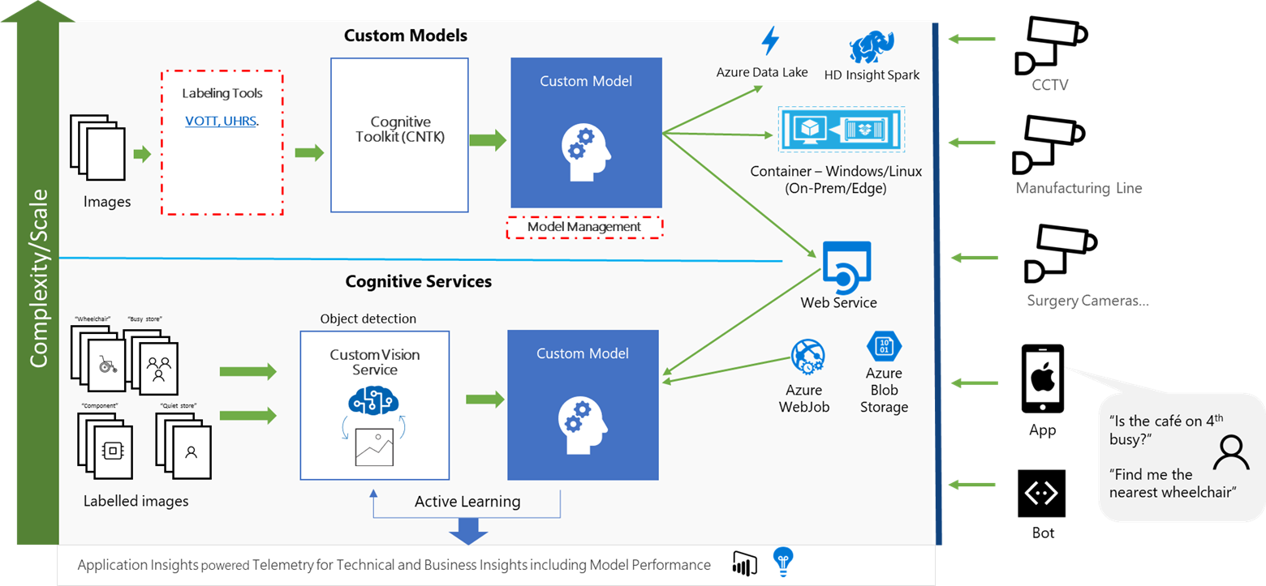
醫院管理
Notes:
So What is Azure AI?
Azure AI is a set of AI services that are built upon Azure and deeply integrated with Azure’s Data, App Development, Compute services and tools.
With Azure Machine Learning, we provide data scientists and developers to build, train and deploy models.
AML is the only cloud ML service that enables developers of all skill levels to build ML models – from a code first experience, to drag & drop, to automated machine learning where developers are not required to have any ML knowledge. No matter how models are built, they are stored and managed in a central registry.
AML also provides advanced MLOPs capabilities with built-in integration with Azure DevOps. This enables developers to achieve model reproducibility, model validation, model deployment and model retraining capabilities.
Finally, AML is built on an open source foundation. Developers can choose the Python tool and process of their choice and even get started on their laptops. They have the freedom to use Mlflow if they’d like and take advantage of the ONNX Runtime to optimize inferencing on multiple HW targets.
Customizable Vision, Speech, Language & Decision Models:
Built with Azure Machine Learning, we also offer developers the most comprehensive set of domain-specific pre-trained models – 30 across Vision, Speech, Language and Decision making – which are all based on our breakthrough research. Not only does Azure AI have the most number of pre-trained models, we are the only ones that can enable deployment anywhere – on-premises, on the edge and even other clouds through the use of containers.
Scenario Specific Services
Finally, we offer AI applications specific services for professional developers.
Azure Bot Service is built on Azure Bot Framework, the most popular open source based bot framework.
This includes Azure Search, which is the only cloud app search service with built-in AI capabilities. This facilitates the creation of knowledge mining apps.
Form recognizer has been designed to work on specific types of documents – forms. It extracts key value pairs from forms, thereby automating data entry tasks.
Finally, we have Video Indexer. Video Indexer that is used to extract in-depth metadata from video and audio content.
Only Microsoft provides such a comprehensive set of capabilities for professional and citizen developer to harness the potential of AI

Slide 36










選擇認知服務理由
簡單
柔性
支援性強
·
key
product
Notes:
为什么选择 API？它们有用，而且非常简单。
简单： 借助简单的 REST 调用，API 很容易实现。 可以通过常见的方式实现 REST API，你可以访问网站 www.microsoft.com/cognitive，免费开始使用所有这些 API。 （无需四处寻找。）
灵活： 我们提供广泛的智能和知识 API，因此开发人员将能够找到所需的智能功能；重要的是，它们适用于开发人员选择的任何语言、框架或平台。因此，开发人员可以使用他们熟悉和喜爱的工具（例如 python 或 node.js 等）将其集成到应用程序（iOS、Android 和 Windows）中。
经过考验：利用由专家开发的不断增加的一系列强大 AI 算法。开发人员可以信任来自 Microsoft 的研究组织、必应和 Azure 机器学习领域的专家所提供的质量和专业知识，这些功能用于许多 Microsoft 的第一方产品（如 Cortana、必应和 Skype）。

Slide 37
Microsoft Cognitive Service 場景應用

Slide 38

疫情下 人工智慧能做什麼

Slide 39
實戰一 通過文件分析，來分析 Covid 19 論文集
1

Slide 40
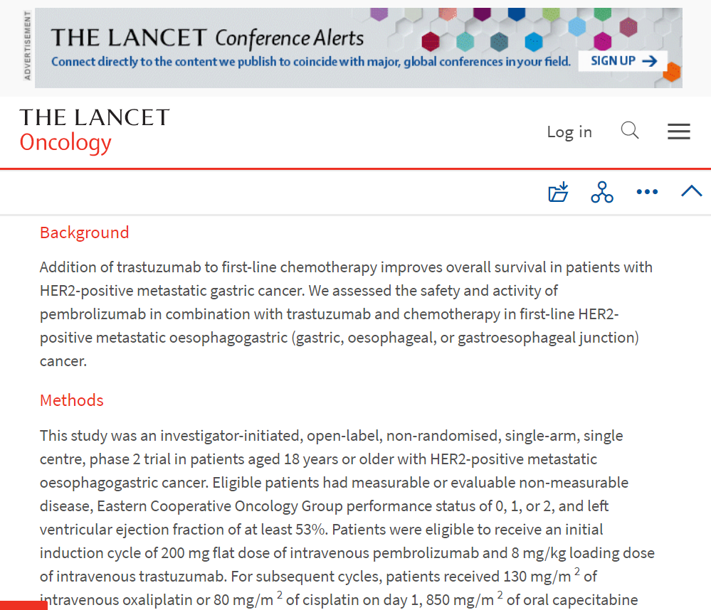
CORD Papers Dataset
CORD-19 Dataset
包含超過 800,000 篇關於 COVID-19 和冠狀病毒家族的學術文章，供全球研究界使用
400,000+ 篇文章全文
Data Source
https://allenai.org/data/cord-19
https://www.kaggle.com/allen-institute-for-ai/CORD-19-research-challenge
Notes:
Francesca
In this session, we show how to leverage CORD dataset, containing more than 400,000 scientific papers on COVID, and recent advances in natural language processing and other artificial intelligence techniques to generate new insights in support of the ongoing fight against COVID.
The CORD-19 dataset represents the most extensive machine-readable coronavirus literature collection available for data mining. In that same dataset, there are about 200,000 articles with full text
Data source links.
This allows the worldwide AI research community the opportunity to apply text and data mining approaches to connect insights across this content.

Slide 41

问题
每月出現大約 30,000 篇與 COVID 相關的科學論文
Notes:
Francesca
One of the major challenges of the COVID-19 pandemic has been finding effective treatments for the virus.
The rapid spread of coronavirus generated an urgent need for comprehensive therapies.
As consequence, the medical research community experienced an acceleration in new coronavirus literature, making it difficult for scientists to keep up.
Just to give you an idea: Around 30,000 scientific papers related to COVID appear monthly

Slide 42
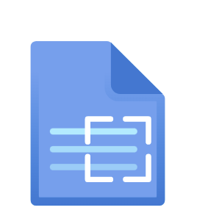


Cognitive Language Services
Text Analytics
Language Understanding
(LUIS)
QnA Maker
預建功能，包括命名實體提取、情感分析、PII 提取、語言檢測、摘要等。
為會話應用程序構建自定義 NLU 模型以對意圖進行分類並提取實體.
www.luis.ai
構建自定義知識庫並為來自非結構化文本的問題提供答案。
www.qnamaker.ai

Slide 43
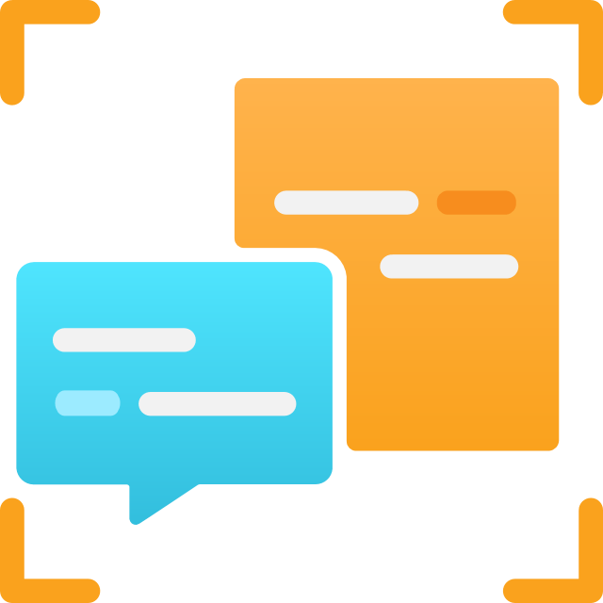
進化後的 Cognitive Service for Language
以前的單獨服務合併為一個功能組下
服務大一統
一個 Azure 資源
一種用戶體驗
一個 SDK
一組 API
一個有凝聚力、更簡單、功能強大的產品
最先進的
多種語言
新的和改進的

Slide 44
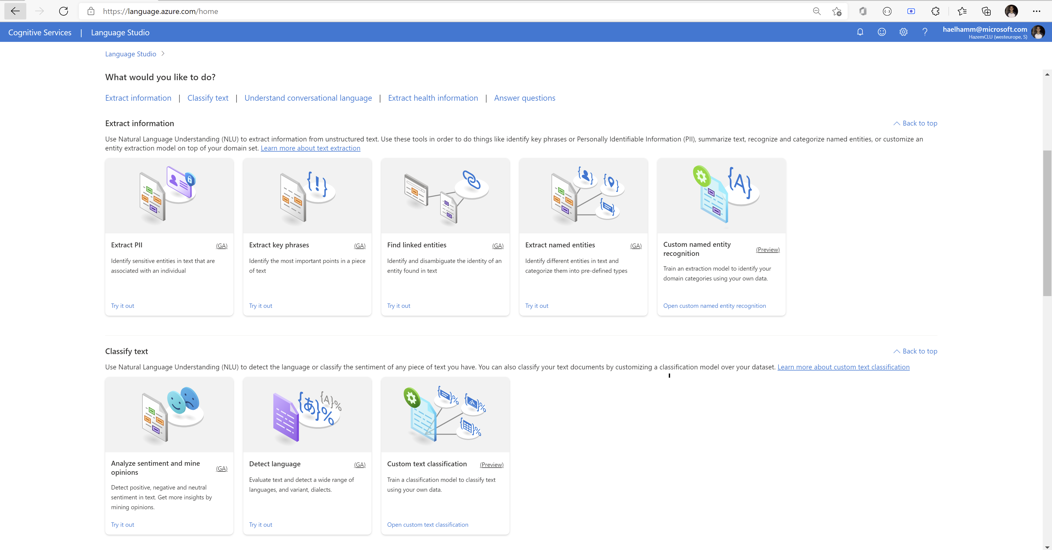
The Language Studio
https://language.cognitive.azure.com

Slide 45
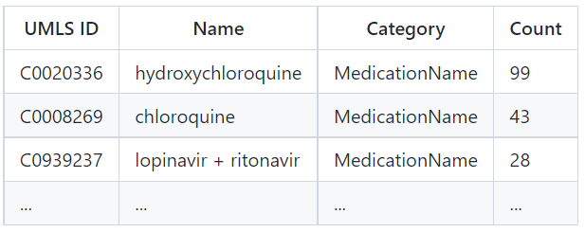
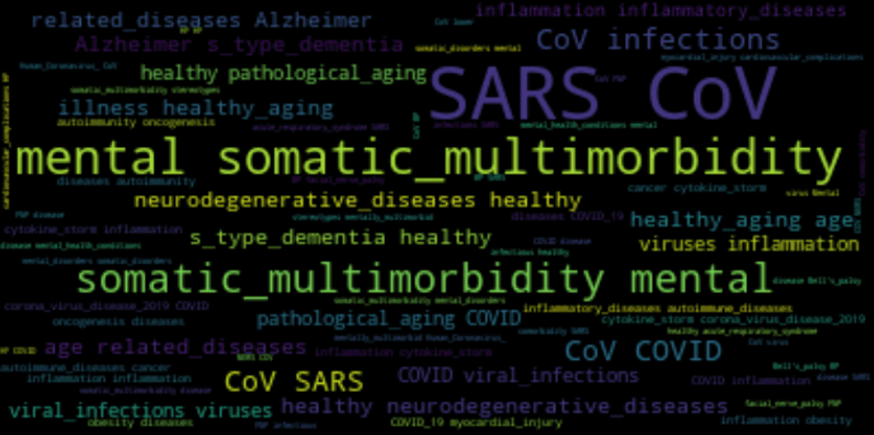
獲取頂級實體（藥物、診斷、..）

Slide 46
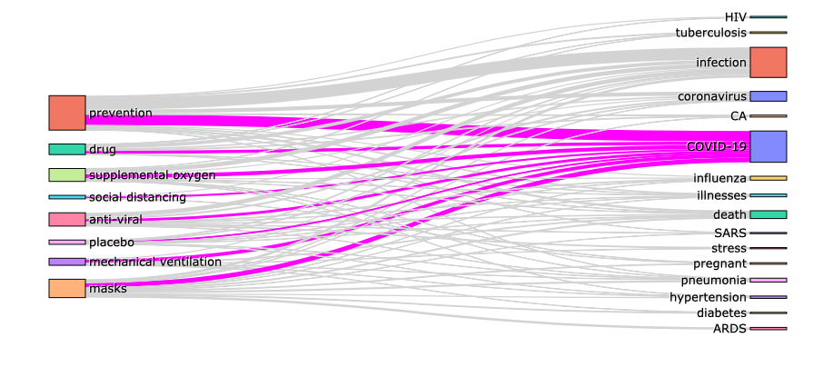
術語關係
Notes:
Dmitry

Slide 47
實戰二 Custom Vision 口罩識別
2

Slide 48
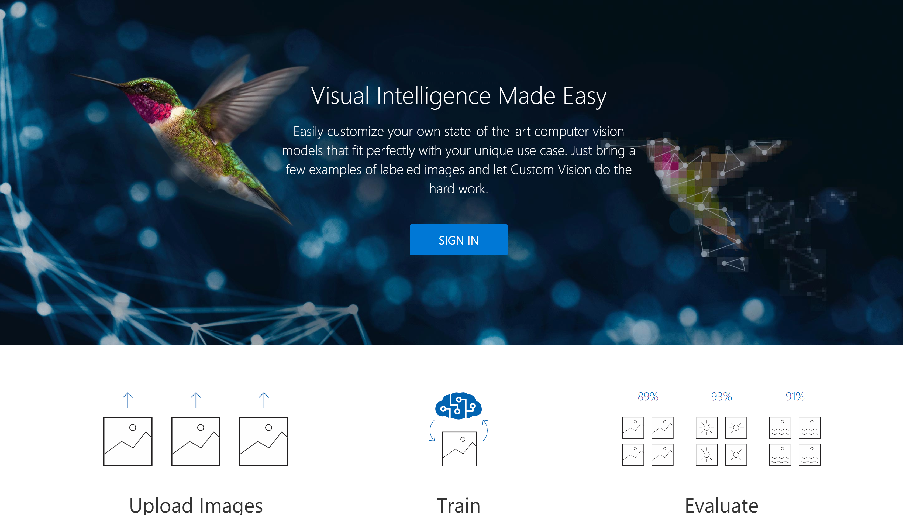
Custom Vision
微軟的認知服務接口，讓你可以在零機器學習的知識下，用不同編程語言完成相關的機器學習工作
CustomVision就更進一步，讓你在沒有編程技術下，完成圖像識別和物體識別的工作，他是一個零代碼解決方案，你只需要一堆圖片集就可以完成工作了，對比起認知服務，你還可以直接導出訓練模型，直接部署到不同的場景上
https://www.customvision.ai/
Notes:
Dmitry

Slide 49
Custom Vision
微軟的認知服務接口，讓你可以在零機器學習的知識下，用不同編程語言完成相關的機器學習工作
CustomVision就更進一步，讓你在沒有編程技術下，完成圖像識別和物體識別的工作，他是一個零代碼解決方案，你只需要一堆圖片集就可以完成工作了，對比起認知服務，你還可以直接導出訓練模型，直接部署到不同的場景上
https://www.customvision.ai/
Notes:
Dmitry

Slide 50
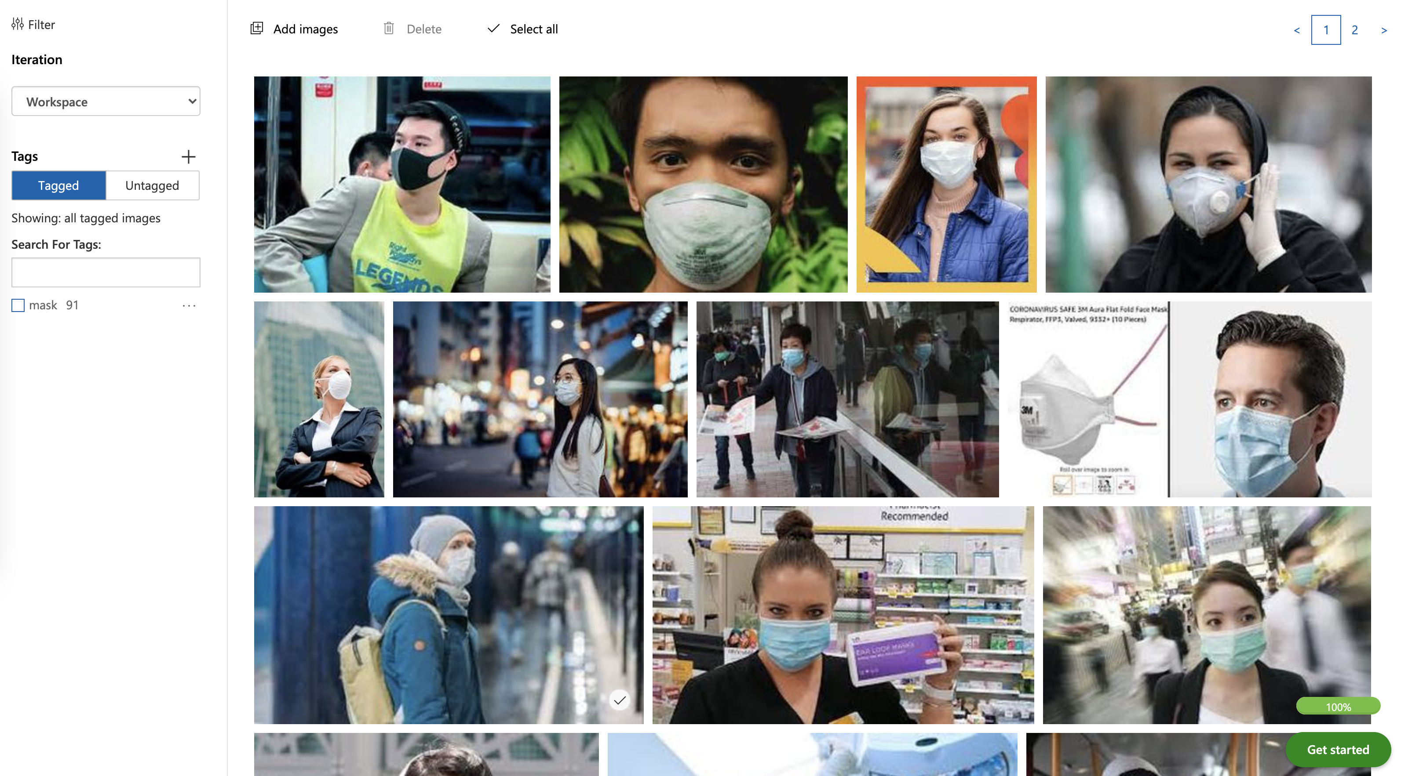
Custom Vision
Notes:
Dmitry

Slide 51
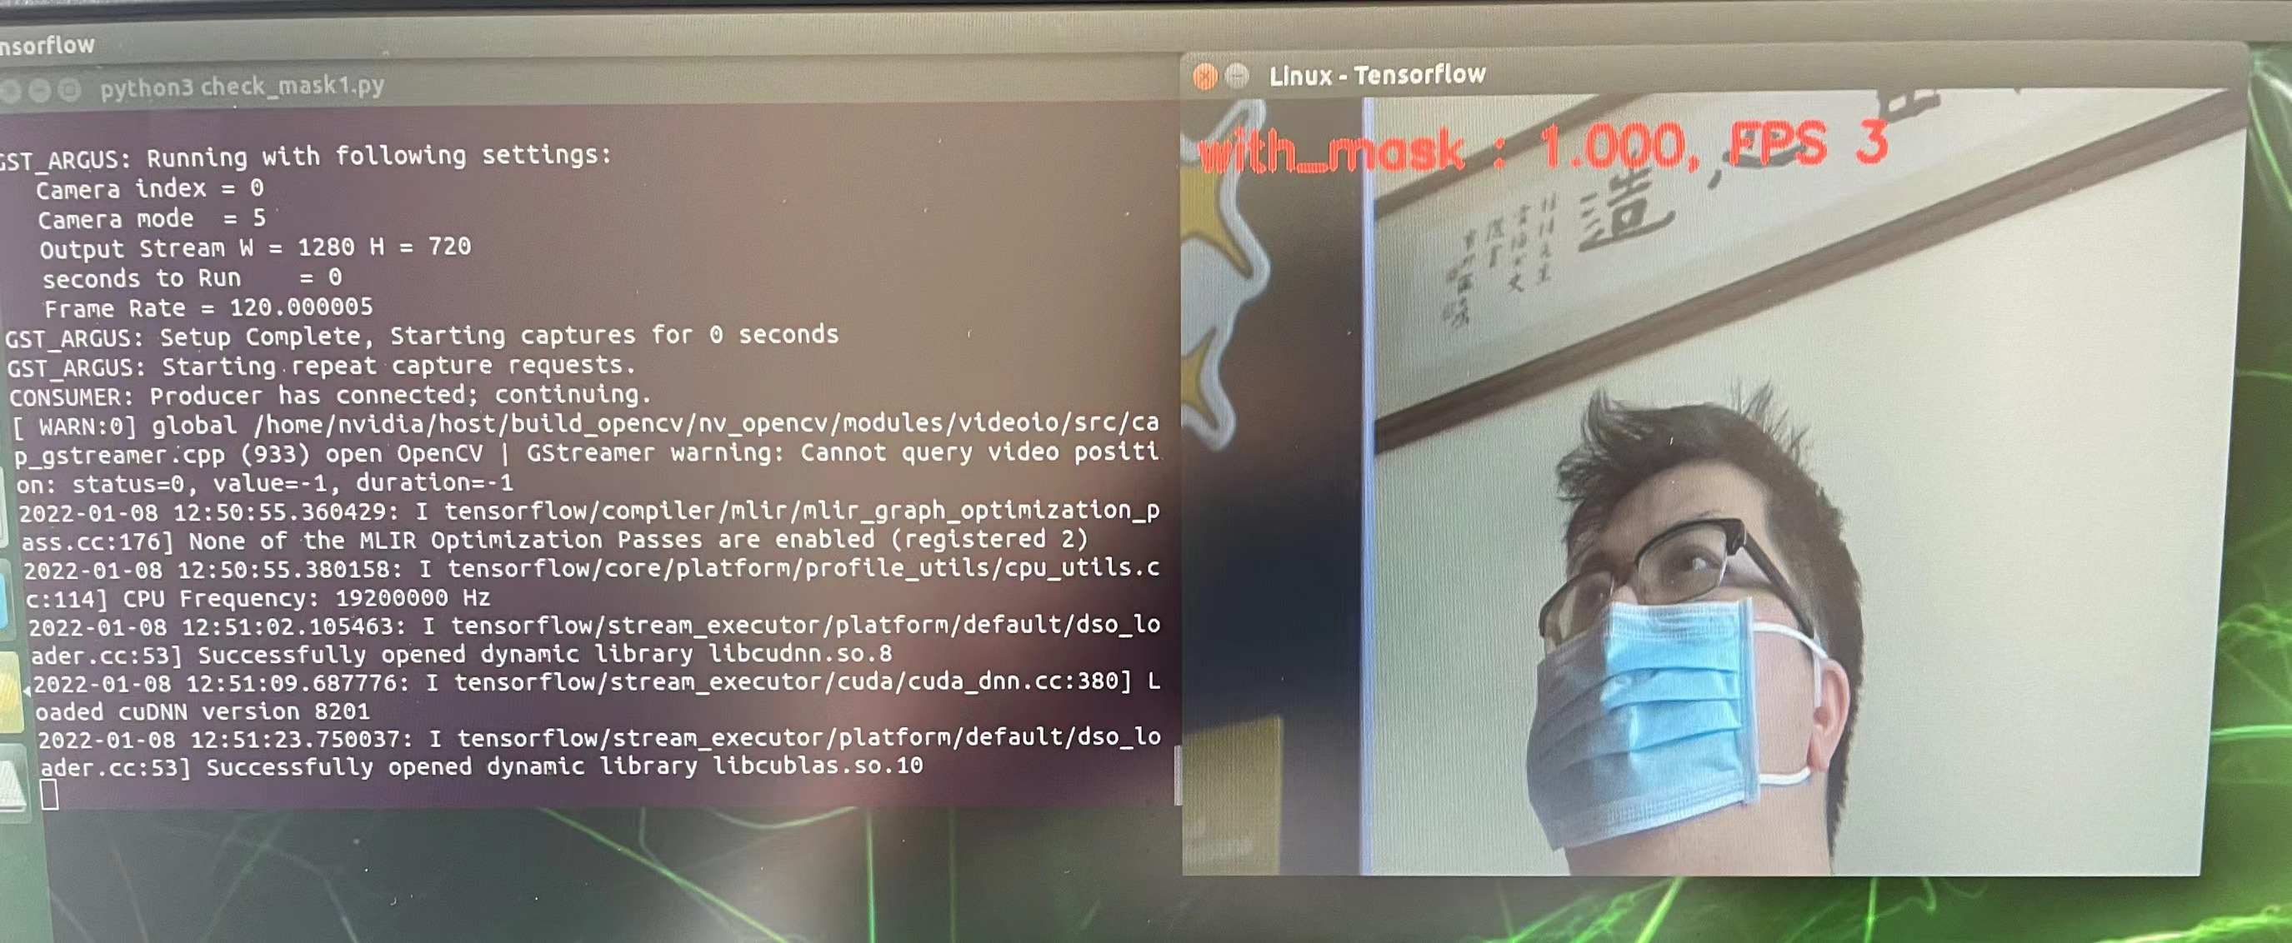
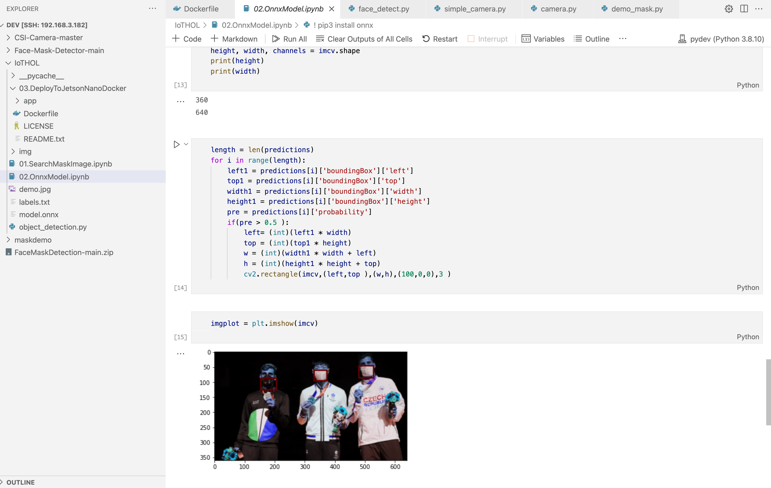
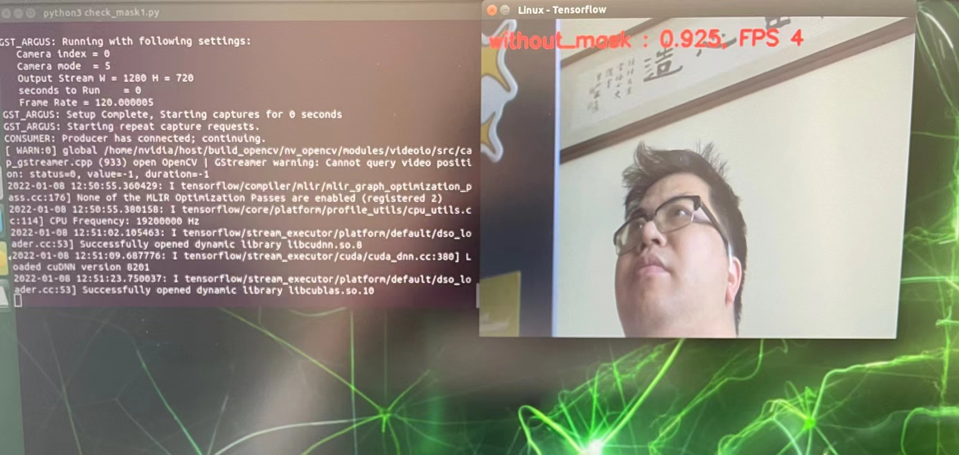
Custom Vision 神兵利器讓你零代碼做口罩識別
Notes:
Dmitry

Slide 52
計算機視覺開始玩起
https://github.com/kinfey/MSCloudAdvocateHKClassRoom/tree/main/AzureCogntiveServiceHandsOnLabHK_202111/AzureComputerVisionHOL/code
OCR
2. 計算機自定義視覺
3. 專業訓練的計算機視覺

Slide 53
實戰三 Covid-19 實況查詢
3

Slide 54

Covid-19
https://www.who.int/emergencies/diseases/novel-coronavirus-2019/question-and-answers-hub/q-a-detail/coronavirus-disease-covid-19
Notes:
Dmitry

Slide 55

Covid-19
Notes:
Dmitry

Slide 56
Chatbot入門
https://github.com/kinfey/MSCloudAdvocateHKClassRoom/tree/main/AzureCogntiveServiceHandsOnLabHK_202111/AzureChatbotHOL/pdf
搭建Chatbot
2. 部署Chatbot到雲端
3. QnA Maker 使用
4. LUIS使用
5. 做一個COVID-19 Chatbot

Slide 57
Thank You!

